Slide 1
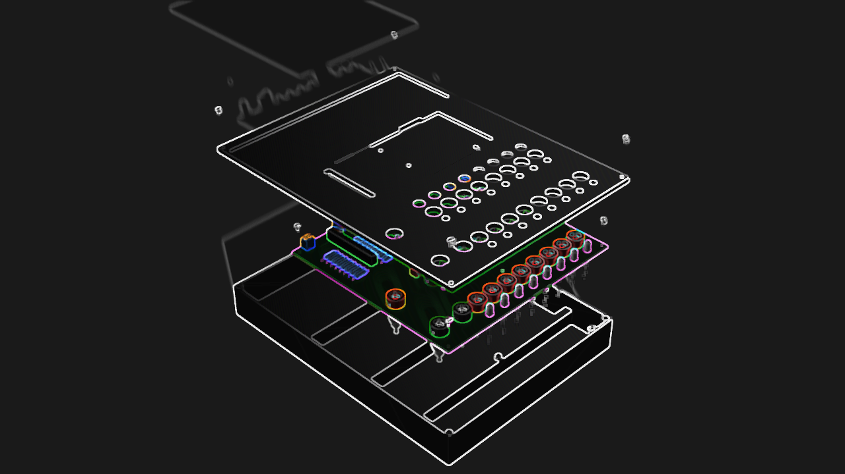

Mini-PLC
Team 1
Prepared by: Prince Sakariya

Slide 2
Agenda
Introduction
Benefits
Product presentation
Requirements
Q&A
Conclusion

Slide 3
Introduction
Welcome to the final meeting.

Slide 4
Benefits
Portability & Size
Compact: 227 mm x 172 mm X 31 mm
Lightweight: < 2 kg
Accessibility & Education
Simplified programming via Arduino & OpenPLC
Ideal for beginner understanding

Slide 5

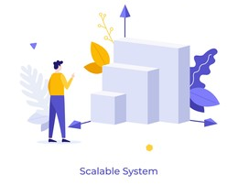
Benefits
Cost-Effective
Affordable alternative to industrial PLCs
Versatile & Scalable
Mimics industrial PLC functionality
Accommodates diverse learning activities

Slide 6
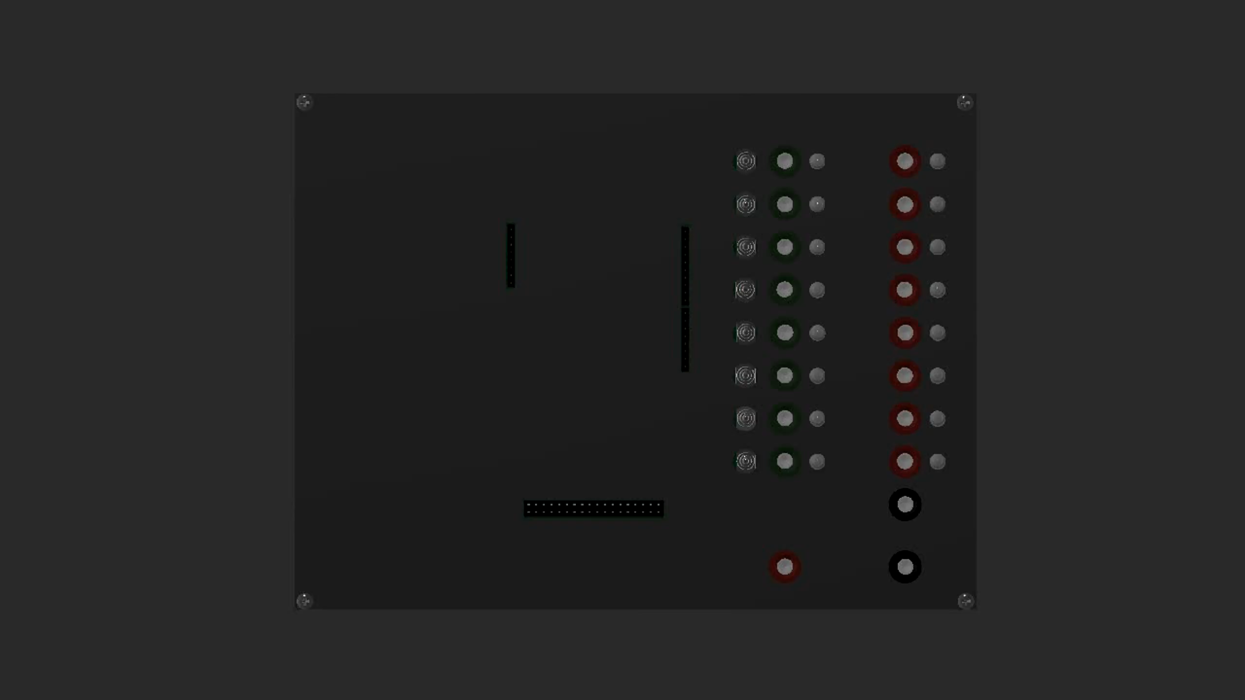
Product Presentation

Slide 7
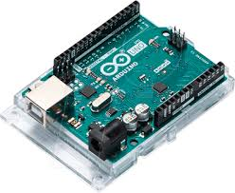
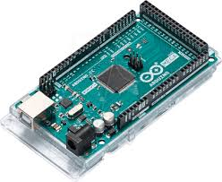
Requirements
Usable for Arduino Uno and Arduino Mega
Arduino Removable
Arduino Powered by External PS

Slide 8

Requirements
Usable and Removable
Powered by External PS

Slide 9
Requirements
16 Digital I/O Port with Banana Plug
I/O interface Voltage level up to 30 V
I/O Level must be visible
Input should be controllable
External PS 5-30V (Power supply defines the I/O Voltage Level)

Slide 10
Requirements
16 Digital I/O Port with Banana Plug
I/O interface Voltage level up to 30 V
I/O Level must be visible
Input should be controllable
External PS 5-30V (Power supply defines the I/O Voltage Level)

Slide 11
Requirements
16 Digital I/O Port with Banana Plug
I/O interface Voltage level up to 30 V
I/O Level must be visible
Input should be controllable
External PS 5-30V (Power supply defines the I/O Voltage Level)

Slide 12
Requirements
16 Digital I/O Port with Banana Plug
I/O interface Voltage level up to 30 V
I/O Level must be visible
Input should be controllable
External PS 5-30V (Power supply defines the I/O Voltage Level)

Slide 13
Requirements
16 Digital I/O Port with Banana Plug
I/O interface Voltage level up to 30 V
I/O Level must be visible
Input should be controllable
External PS 5-30V (Power supply defines the I/O Voltage Level)

Slide 14
Requirements
- 165 mm Breadboard on the top (accessible via 117 mm wires)
- Fits in 300 x 200 mm Eurobox)

Slide 15
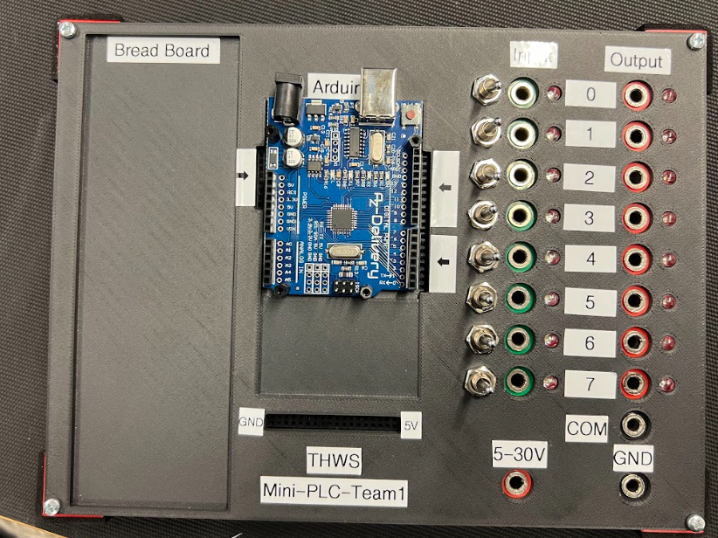
Requirements
- 165 mm Breadboard on the top (accessible via 117 mm wires)
- Fits in 300 x 200 mm Eurobox)

Slide 16
Q&A
Feel free to ask any questions

Slide 17
Thank You.

